Slide 1

Quantum Tunneling

Slide 2
What is Quantum Tunneling ?

Slide 3
If K.E.<P.E.
Kinetic Energy
Potential Energy

Slide 4
An electron containing energy
But this is not the case With Quantum Particles……
e⁻
e⁻

Slide 5
So, How does it work ?
From Heisenberg’s uncertainty principle we know that we can’t predict an electron’s position and momentum at the same.
However in quantum particles we have a high probability that our electron is somewhere on the left side of the barrier.
We can show this probability with a wave function.
So, when this wave comes in contact with the barrier, it reflects according to the rules of total internal reflection.
But there is a very small part of the wave who gets into the barrier and travels exponentially decreasing path.
So if the width of the barrier is small then there is a probability that we will find our wave on the other side having very small amplitude.
This small probability is also known as ‘tunneling probability’ or ‘transmission probability’.

Slide 6
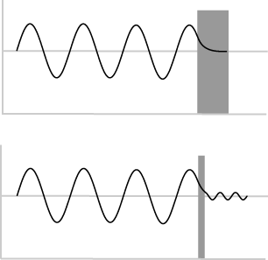
High Probability
Exponentially Decreasing
Low Probability
Barrier width

Slide 7


Tunneling Probability
As we are talking about the probabilities of finding electron at the other side of the barrier which is also known as ‘tunneling probability’.
It also has a mathematical expression.
We can also write it as
T(L,E) = e^{-2bl}(approx.)
Where
T=Tunneling Probability E=Energy of electron Uo=Height of barrier
L=length of barrier b=

Slide 8
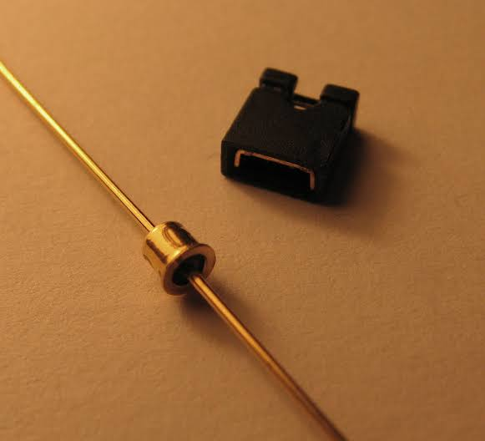
Applications of Quantum Tunneling
1.
Tunnel Diode:-
A tunnel diode is a type of semi conductor diode that has effectively negative resistance due to quantum tunneling

Slide 9
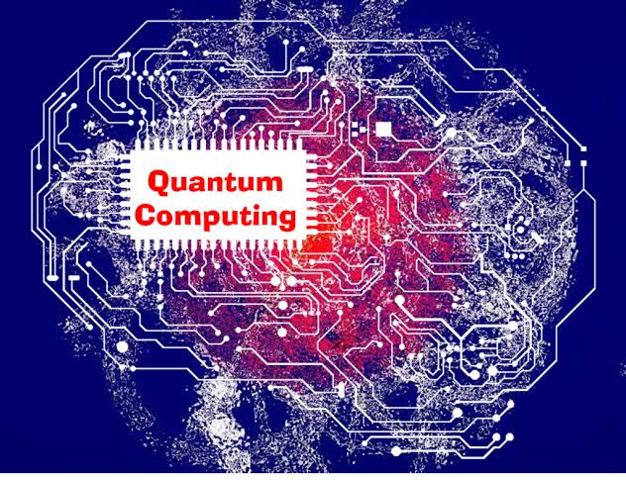
2.
Quantum Computing:-
Quantum computing is the use of Quantum phenomena as tunneling and superposition to perform computation.

Slide 10
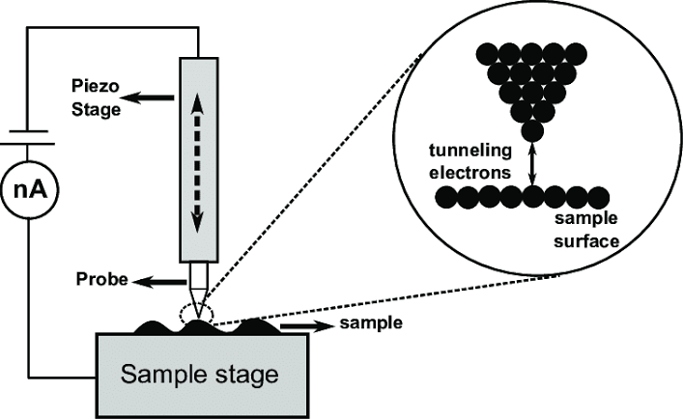
3.
Scanning Tunneling Microscope:-
A scanning tunneling microscope is an instrument for imaging surfaces at the atomic level.

Slide 11

THANK YOU

